Slide 1
Welcome to CRPS Treasurer’s Zoominar

Slide 2
Your Lodge is a Class D Member of the Canadian Royal Purple Not for Profit Society
Your LODGE - A Group of like-minded people who came together to carry out shared aims and objectives by forming a lodge and joining the CRPS as a Class D member
Your Lodge is a member of a Federally incorporated
Not For Profit Society and a Provincially incorporated Not For Profit
YOU ARE THE TREASURER ☺

Slide 3
What does this mean?
Your Lodge has all the rights and privileges of a Not For Profit
Gaming privileges
Governance model
Liability coverage for executive decisions
Operating under an umbrella of Not-For-Profit Legislation

Slide 4
AND
Our National Board, Constitution and our CRPS governance saves your lodge from having to deal with two levels of government reporting.
CRPS collects your reports as its promise and responsibility to the Federal and Provincial Not For Profit legislation requirements.
To ensure you are operating according to their requirements, the following information is required:
Meeting regularly, following formal governance
Maintaining membership lists, approved minutes
Holding an annual AGM
Maintaining audited (reviewed) financial records
Developing an annual budget
Operating under the Gaming legislation

Slide 5
Membership
You may have three types of members (shareholders) in your not-for-profit lodge:
Class A – this is the regular membership – voting
Class B – a Past National President - voting
Class E – a non-voting lifetime member

Slide 6
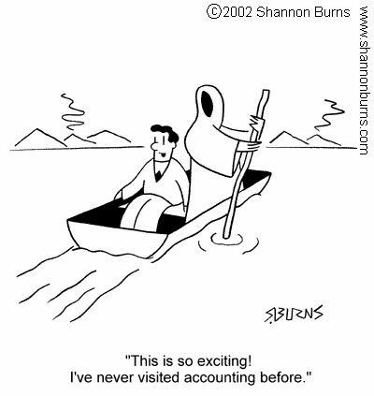

Slide 7
Treasurer’s Role and Duties
1. Member of your Lodge Executive committee.
2. Take care of your Lodge finances.

Slide 8
Banking
Issue cheques - make sure you have a motion before you write a cheque!
Make the deposits
Balance and reconcile your bank accounts monthly
Gaming laws are very strict so ensure that you keep accurate records and get receipts for all donations from that account
Provide all banking information to the Finance Committee for the annual internal review
A copy of the minutes with the motion approving the change of signing authorities will be required by the bank

Slide 9
Reports
Treasurer’s Report – this will include all receipts and expenses for the month as well as the bank balance. This needs to be presented at every Lodge meeting.

Slide 10
Financial Records
Financial records are to be kept for a minimum of 7 years
Records to be kept include: ledgers, bills, receipts, deposit books and bank statements with cancelled cheques

Slide 11
Financial Review - audit
Difference between an Audit and Financial Review – an Audit you hire a professional accountant and pay for the audit, a Financial Review is completed by 2 or more members who do not have signing authority
If your Lodge chooses to use a Financial Review you need to make a motion annually and have it approved by your members
It is mandatory that a Financial Review is conducted annually
You as Treasurer will make available all of the financial information, banking, ledgers, bills.
If for any reason your Treasurer is replaced during the year, a Financial Review would be required. This ensures that the books were turned over in good order.
The Treasurer may attend the Financial Review, but cannot participate in the review other than to answer questions.

Slide 12
Membership
Receive
Receive Members’ annual fees and record them
Know
Your secretary needs to know who has not paid – the National Membership Form must be submitted to National Office no later than January 15th
Submit
Submit Membership fees, Lodge dues and insurance payments to National Office – this is done in conjunction with your Secretary submitting the annual National Membership form.
Members should receive a receipt or a membership card

Slide 13
Sample of Membership Tracking
MEMBERSHIP RECEIPTS FOR XYZ LODGE
 | 2019 |  | 2020 |  | 2021
MEMBER | Date rec'd | Amount | Date rec'd | Amount | Date rec'd | Amount
Bambrick, Barb | 12-Dec-18 | $ 50.00 | 05-Nov-19 | $ 50.00 | 06-Nov-20 | $ 45.00
Conley, Elsie | 12-Dec-18 | $ 50.00 | 05-Nov-19 | $ 50.00
Gammie, Jan | 12-Dec-18 | $ 50.00 | 05-Nov-19 | $ 50.00 | 06-Nov-20 | $ 45.00
Kitz, Anita | 04-Jan-19 | $ 50.00 | 05-Nov-19 | $ 50.00 | 06-Nov-20 | $ 45.00
Lougheed, Sandi | 10-Nov-18 | $ 50.00 | 05-Nov-19 | $ 50.00 | 06-Nov-20 | $ 45.00
McCarthy, MaryLou | 12-Dec-18 | $ 50.00 | 05-Nov-19 | $ 50.00 | 06-Nov-20 | $ 45.00
Nolan, Lynda | 10-Nov-18 | $ 50.00 | 05-Nov-19 | $ 50.00 | 06-Nov-20 | $ 45.00
Stotz, Carrie | 10-Nov-18 | $ 50.00 | 05-Nov-19 | $ 50.00 | 06-Nov-20 | $ 45.00
 |  | $ 400.00 |  | $ 400.00 |  | $ 315.00

Slide 14
What’s Excel??
Excel is a spreadsheet program on Microsoft Office. It comes with the Word program. If you do not have access to this program this information can all be entered in a manual ledger or any other spreadsheet program.
Excel lets you enter numbers, names, dates in a column and row format. You can have your columns automatically total with the autosum feature.
Basic rule of thumb is to keep your columns matching your budget items.
To keep things simple I have created some basic templates that I would be happy to share and teach you how to use.

Slide 15
Monthly Detail on Excel spreadsheet
Jan-20
REVENUE |  |  | Catering | Dues | Sunshine
Sandi Lougheed |  |  | $ 346.00
All members |  |  |  | $ 1,740.00 | $ 13.70
MaryLou McCarthy |  |  | $ 1,692.00
 |  |  | $ 2,038.00 | $ 1,740.00 | $ 13.70 | $ 3,791.70
EXPENSES | Chq # |  | Groceries | Supplies | Members | Nat Dues | Lodge Dues
ABC Grocery | 1511 | $ 147.71 | $ 147.71
Meat Store | 1512 | $ 696.92 | $ 696.92
DEF Grocery | 1513 | $ 432.48 | $ 432.48
Jan Gammie | 1514 | $ 65.93 | $ 65.93
Lynda Nolan | 1515 | $ 66.14 |  | $ 66.14
Anita Kitz | 1516 | $ 117.73 | $ 45.98 | $ 34.89 | $ 36.86
CRPS | 1517 | $ 1,765.00 |  |  |  | $ 1,740.00 | $ 25.00
Jim Matthews | 1518 | $ 100.00 |  |  | $ 100.00
 |  | $ 3,391.91 | $ 1,389.02 | $ 101.03 | $ 136.86 | $ 1,740.00 | $ 25.00
Feb-20
EXPENSES
M. McDonald |  |  | Donation
Encounters of Cananda | 1519 |  | $ 300.00
Mar-20
REVENUE |  |  | Catering | Sunshine | Dues
Smith Lunch |  |  | $ 200.00
Jones Funeral |  |  | $ 1,100.00
 |  |  |  | $ 27.00 | $ 35.00
Total |  | $ 1,300.00 | $ 1,300.00
EXPENSES |  |  | Groceries | Donations
Carrie Stotz | 1520 | $ 287.22 | $ 287.22
BDSS | 1521 | $ 50.00 |  | $ 50.00
Jan Gammie | 1522 | $ 15.00 | $ 15.00
ABC Grocery | 1523 | $ 116.57 | $ 116.57
DEF Grocery | 1524 | $ 75.94 | $ 75.94
Meat Store | 1525 | $ 94.73 | $ 94.73
 |  | $ 639.46 | $ 589.46 | $ 50.00
This is to track the detail of your banking on a monthly basis.

Slide 16
Sample of Accounting
CANADIAN ROYAL PURPLE EXAMPLE ACCOUNTING |  |  | Accounting Jan 1, 2020 to Dec 31, 2020
 | Budget | Total | Jan | Feb | Mar | Apr
Revenue
Catering | $ 6,000.00 | $ 3,338.00 | $ 2,038.00 |  | $ 1,300.00
Membership Dues | $ 1,740.00 | $ 1,740.00 | $ 1,740.00 |  | $ -
Sunshine March | $ 100.00 | $ 40.70 | $ 13.70 |  | $ 27.00
Misc | $ - | $ -
Total | $ 7,840.00 | $ 5,118.70 | $ 3,791.70 | $ - | $ 1,327.00 | $ -
Expenses
Donations | $ 3,000.00 | $ 350.00 |  | $ 300.00 | $ 50.00
Member Expenses | $ 500.00 | $ 136.86 | $ 136.86
Catering Expenses | $ 3,500.00 | $ 1,978.48 | $ 1,389.02 |  | $ 589.46
Supplies | $ 200.00 | $ 101.03 | $ 101.03
National Memebership | $ 1,740.00 | $ 1,740.00 | $ 1,740.00
Lodge Dues | $ 25.00 | $ 25.00 | $ 25.00
Lodge Insurance | $ 158.00 | $ 158.00 | $ 158.00
Advertising | $ 100.00 | $ -
Bank Charges | $ 40.00
Total. | $ 9,263.00 | $ 4,489.37 | $ 3,549.91 | $ 300.00 | $ 639.46 | $ -
GENERAL BANK ACCOUNT BALANCE
January Opening | $ 5,000.00
February | $ 5,241.79
March | $ 4,941.79
April | $ 5,629.33
Excel Spreadsheet available to customize
Easy to use

Slide 17
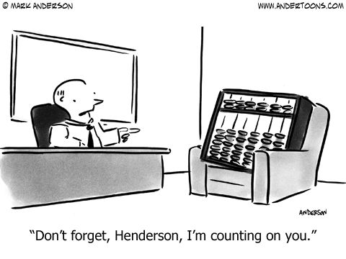

Slide 18
MISCELLANEOUS
The Treasurer does not prepare the Budget.
The budget is prepared by the Executive Committee, with information provided by the Treasurer and Finance Committee.
The budget must be presented to your Lodge at your AGM for member approval.

Slide 19
Thank you so much for attending!
Any questions or comments?

